Slide 1
AGENDA:
Time: Item:
6:30pm – 7:00pm Shareholders arrival
7:00pm - 7:10pm Welcome
7:10 pm - 7:20pm Richard Pontin – Looking back / looking forward
7:20 pm - 7:40pm Accountants – Ramsay Brown
7:40 pm – 8:00pm Chairman & Finance Lead – Finance Overview
8:00 pm - close Q& A …..Dinner
11th April 2025

Slide 2
Healthbridge Direct :
Looking Back ……2024/25
Achievements:
Delivered on all our contracts / Pilots – EA / SDA / LTBi / SWC / LTC / Pilots
(managed to deliver where local federations haven’t ….E-hubs)
Decreased running costs eg Re-negotiated non clinical contracts
Increased organisations reputation // Continue to built on strategic relationships
Added value for our share-holders
Maintained stable workforce in core team // Grown our locum work-force
Trusted provider

Slide 3
Healthbridge Direct :
Looking Forward ……2025/26 …and beyond
Risks / Unknowns:
ICB / Redbridge Council / Acute (BHRUT) …. All financially challenged
Reform in NHS …. NHSE abolished // ICB to reduce to 35% w.force // 10 yr plan to achieve transformational goals of..
Acute to community
Analogue to digital
Sickness to prevention
Movement to Integrated Neighborhood teams (INTs) …5 year process

Slide 4
Healthbridge Direct :
Looking Forward ……2025/26 …and beyond
Strategy:
Retaining good PCN relationship is vital….Supporting PCNs in migrating to INTs
HBD positioning itself as an integrator for INT’s
INTs need ….
Clear leadership structures / Governance frameworks …aligment of teams visions/ objectives
Workforce – planning training development ….ID gaps, plan roles etc
HR support – issues will arise due to complexity of the varying teams
Data sharing / digital integration
Business intelligence
Financial Management / oversight
Performance Management & evaluation

Slide 5
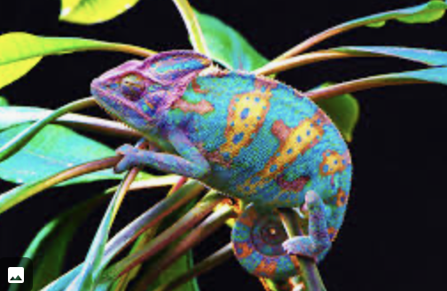
Healthbridge Direct :
Like a Chameleon …..
HBD – needs to adapt to adapt to the changing surroundings to survive.
Current roles of HBD – mostly focused on delivery of clinical services.
Might to change to be predominantly a back-office support organization.
Unlike a Chameleon….
Chameleon uses its adaptation to blend in ….
HBD wants to stand out !!!

